Slide 1

Basic
AutoTag Training
Dec 13, 2017

Slide 2

Introduction
Windward Training Facilitator
Erik Johnson
Technical Support Engineer

Slide 3
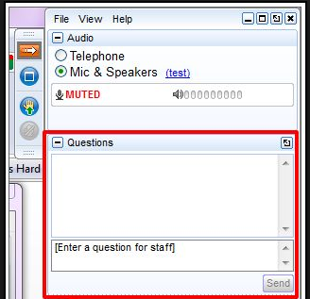
Asking Questions
Use the GoTo Meeting “hand” icon to ask a question

Slide 4
Demonstration Environment
This is a basic introduction to AutoTag
Demonstration environment:
  Windows 10 (64-bit)
  Office 2016 (64-bit)
  AutoTag 15.2.133.0

Slide 5
Overview
Getting started
Navigating the environment
Creating a template
ForEach and Out Tags
Input Parameters
Data source Wizards
Generating a report or document
Getting help

Slide 6
AutoTag Environment
AutoTag Manager Tab - connect to data
  Data Sources
  Find/Replace tool
  About button
  License
  Samples
  Tutorials

Slide 7
AutoTag Environment
AutoTag Tab - template design
  Creating & selecting tags
  Data Bin
  Tag properties
  Wizard
  Input Parameters
  Generate output

Slide 8
ForEach Tag
Two components:
  ForEach Tag - fetches a specific dataset from your data source and creates a repeating loop
  End ForEach Tag - tells the loop to stop repeating content

Slide 9
Out Tag
The Out Tag is the most common tag
It tells the template to:
  Grab one item of data (number, text, image, date, currency, etc.)
  Display that data

Slide 10
SQL and XML Wizards
  SQL
    Sorting ascending and descending
    Dynamic filters
  XML
    XPath query language
    Sorting ascending and descending
    Static filters

Slide 11
Input Parameters
  Allow users to add input just before generating output
  Add a default value
  Reference a parameter in a tag
  Prompt for value

Slide 12
Support Resources
Make sure you check out our support resources:
  wiki.windward.net - knowledge base
  support.windward.net
  store.windward.net - retrieve your license keys
Have a feature or change you want to see?
  ideas.windward.net

Slide 13
Intermediate Training Topics
Next week
  Advanced ForEach Tags
  If/Else Tags
  Switch/Case Tags
  Conditional Formatting
  Adding Functions or Equations
  Importing sub templates
  AutoTag for Excel differences

Slide 14
Q&A
Ask away!

