Slide 1

Intermediate
AutoTag Training
Dec 20, 2017

Slide 2

Introduction
Windward Training Facilitator:
Erik Johnson
Technical Support Engineer

Slide 3
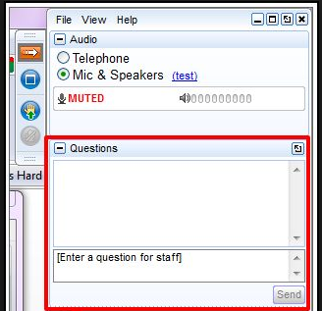
Asking Questions
Use the GoToMeeting “hand” icon to ask a question

Slide 4
Demonstration Environment
This is an intermediate AutoTag webinar
Demonstration environment:
  Windows 10 (64-bit)
  Office 2016 (64-bit)
  AutoTag 15.2.133.0

Slide 5
Overview
ForEach Tag: Grouping
ForEach Tag: Advanced Properties
Conditional formatting
Equation Editor
If Tag & Switch/Case Tag
Import Tag
AutoTag Excel differences
Q & A

Slide 6
ForEach Tag
  Grabs a set of data
  Loops through that set of data
  Repeats content between tags
  Also:
  Location of starting and ending ForEach Tags is important
  Grouping data (nesting ForEach Tags)

Slide 7
ForEach Tag
ForEach Tag types
  Row - default style
  Column - create columns, not rows
End ForEach Tag option
  Delete Row – deletes the row where the End ForEach Tag is placed

Slide 8
Equation Editor
Over 50 equations available
Select data through the Wizard
Format applied to Out Tag for currency, number, text, etc.

Slide 9
If Tag
Use a starting If Tag and ending If Tag
Whatever the tags surround will be displayed if the If Tag evaluates as True
Optional Else Tag can be used
Can have nested If Tags

Slide 10
Switch Tag
  Shorter way of writing multiple If/Else Tags
  Convenient for checking a value against multiple possibilities

Slide 11
Excel Differences
Tags work with native Excel macros
Multiple tags can exist in a single cell
Tags longer than 255 chars will be concatenated for you
Native charts supported

Slide 12
Support Resources
Make sure you check out our support resources:
  wiki.windward.net - knowledge base
  support.windward.net
Have a feature or change you want to see?
  ideas.windward.net

Slide 13
Questions
Ask away!

